Slide 1
Common Ground Rising
Presentation for Abq Peace and Justice Groups
This presentation is made for educational purposes to give a general understanding of issues and law and it is not intended to give legal advice

Slide 2
Points of View
To Ban Fracking or Not To ban Fracking and When
The MORA Ban of Fracking and its Precedent
What our alternatives are for protection
Why an Ordinance is important
Safety Concerns – Pipeline Exposures IN Placitas
Water, air and Health Concerns
Our Proposals for moving forward

Slide 3
Aspects of the Mora Decision
Background: In 2013, Mora County Commissioners passed the “Mora County Community Water Rights and Local Self-Government Ordinance,” which essentially prohibited all mineral extraction in the County. The rationale behind this ordinance was concern among county residents and landowners that mineral production could pose threats to water quality, ecosystems, and the health of the land.
LAWSUIT: In January 2014, SWEPI, LP, an oil and gas production company, filed suit challenging the validity of the ordinance. It brought a number of claims, including allegations that the ordinance violated the Supremacy Clause, Equal Protection Clause, Due Process Clause, Dormant Commerce Clause, the First Amendment, and the Fifth Amendment. SWEPI then moved for summary judgment on a number of these claims
RULING: In a 199-page ruling, the court thoroughly considered each of the claims brought by SWEPI. [Read full opinion here.] Here is a summary of the court’s ruling on each claim.
(1) SWEPI’s Fifth Amendment Claim Is Not Ripe. SWEPI claimed that the ordinance constituted a taking of private property for which it was owed just compensation. The Court, however, held this claim was not ripe for decision at this time. In order to prove a takings claim is ripe for decision, a plaintiff must show how a regulation will be applied to the property in question and the challenge may not be brought until the property owner has sought compensation from the governmental entity accused of the taking. Here, SWEPI failed to seek compensation from Mora County as allowed by the New Mexico inverse condemnation statute. Thus, the court refused to consider the Fifth Amendment claim..

Slide 4
Mora Ruling implications
(2) The Ordinance Violates the Supremacy Clause. The Supremacy Clause essentially provides that federal law will trump (or pre-empt) conflicting state law. The court found that four sections of the ordinance violate this clause. Each of the improper sections dealt with Mora County’s attempt to strip corporations of constitutional rights. But the United States Supreme Court has previously found that corporations are “persons” such that they are entitled to protections of the Equal Protection Clause, and have rights under the First and Fifth Amendments. Simply put, Mora County has no power to contradict or nullify constitutional rights recognized by federal law. Moreover, Mora County attempted to prohibit a corporation from arguing that federal law pre-empted the ordinance. Again, Mora County has no power to determine when federal claims may be brought.
(3) The Ordinance Does Not Violate the Due Process or Equal Protection Clauses. Where a law is passed that discriminates against different groups, but does not involve a fundamental right (i.e. right to vote), the law does not violate equal protection or substantive due process so long as there is a legitimate governmental interest the classification created. Here, Mora County prohibited only corporations from oil and gas production, but did not enact a similar ban for individuals. SWEPI argued that this constituted discrimination with no legitimate basis. The court disagreed, finding that Mora County had a legitimate basis for prohibiting corporations from extracting minerals in the county because it is likely that only corporations would have the resources to engage in oil and gas production, which the County believed could endanger the environment. Because the property rights at issue in this case are not considered a fundamental right, and because Mora County had a legitimate interest in treating corporations differently than individuals under this law, no violation occurred under the Due Process or Equal Protection Clauses.
(4) The Ordinance Violates the First Amendment by Chilling Protected Speech. The provision in the ordinance which attempts to strip corporations of First Amendment Rights is invalid. This provision is substantially overbroad and restricts First Amendment rights that are clearly afforded to corporations under federal law.

Slide 5
Mora Ruling Aspects
(5) Mora County Lacks Authority To Impose Zoning Laws on State Land. The ordinance is silent as to whether it applies to state lands, but Mora County argued that it could be applied to state-owned land because extraction on that land could impact neighboring private properties. Because a County does not have the legal authority to impose zoning regulations on land owned by the State of New Mexico, the ordinance would be invalid as applied to any state-owned land.
(6) The Ordinance Conflicts with New Mexico State Law by Banning Production. Local laws may conflict with state law and, if they do so, they will be pre-empted and held invalid. There are two types of pre-emption recognized: Field and Conflict.
Field pre-emption occurs when it is clear from the law that the Legislature intended to control a particular area of law. SWEPI argued that state law pre-empted the field of oil and gas production. The court rejected that argument. While there are certainly state laws related to oil and gas production, there is no language indicating that the Legislature intended the state to be solely responsible for passing regulations related to oil and gas. Instead, there is room for concurrent local and state regulation in certain areas on which the State has not passed regulations.
Conflict pre-emption occurs when a local law expressly conflicts with a state law. Here, because Mora County banned oil and gas production, which is an activity expressly allowed by state law, conflict pre-emption occurred.

Slide 6
Mora Decision Implications
Scrapped Drilling Ban Leaves Open Window for Local Rules: This article discusses how the opinion leaves the possibility of other, less drastic, local measures being upheld.
Federal Judge Strikes Down Local Fracking Ban: This article discusses other similar legal challenges to bans going on across the country.
Rejected Fracking Ban May Cost NM County Hundreds of Thousands in Legal Fees: This article opines that attorney fees sought by the plaintiffs could total over $100,000.

Slide 7
What Happens Now?
According to media reports, Mora County is considering an appeal of the court’s decision. If taken, that will be heard by the United States Court of Appeals for the Tenth Circuit. Additionally, because SWEPI was successful on its claims, it will likely seek recovery of its reasonable attorney’s fees and costs from Mora County.
What Can We Learn?
The clearest lesson from this opinion is that local laws that prohibit all oil and gas production activities are likely going to face numerous constitutional issues. Chief among these will likely be issues involving the Supremacy Clause and the 5th Amendment takings clause.
Additionally, this case makes clear that a local ordinance may not strip corporations of Constitutional rights guaranteed to both individuals and corporations by federal law. Local authorities considering oil and gas bans would be well served by omitting this type of language as it is a fairly easy legal decision that such provisions are not permitted.
Finally, although the ruling invalidates the broadly drafted ban passed in Mora County, this issue is not likely to go away. This opinion potentially leaves the door open for less restrictive local ordinances. For example, the court stated that there are certain issues related to oil and gas production that are not addressed by state law, which leave room for county regulation. As examples, the court listed traffic, noise, nuisance claims from sound, dust, or chemical run off, and the potential negative impact on neighboring landowners.

Slide 8
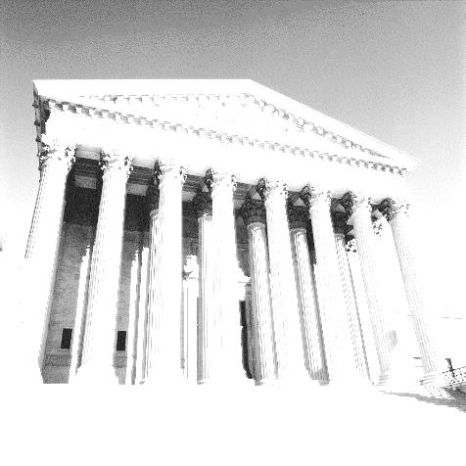
Some Legal Realities
County is limited to “police powers”
to protect health, welfare and safety
State and federal requirements “preempt” County;
County can extend, but cannot conflict with regulations
Cannot have “arbitrary and capricious” requirements;
Rules must be justified as within “police powers”
Need a mechanism to avoid takings without due process or just compensation
Each attribute has both explicit and traditional legal interpretations

Slide 9
Some Key Perceptions or Axioms
A total ban on oil and gas is seen to be legally iffy,
and possibly undesirable.
A laissez faire approach to regulation is seen
to risk multiple undesirable consequences.
Some level of allowing oil and gas development
with a tight protective regulation may be an appropriate compromise.
The industry is believed to know how to operate safely;
however, it can use a positive incentive to do so.
The Oil Conservation Division mostly regulates “down hole” behavior;
local governments are left to regulate on-the-surface behavior
Handful of wells cannot justify other needed facilities and infrastructure,
many hundreds, or thousands, will be needed to keep industry going

Slide 10
What Could Go in the Ordinance?
The County Could Set an Admission Price --
Common Sense Requirements
that
A Responsible Operator Should Follow
Even Without an Ordinance
Could Legally Require: Transparency, Competence, Baselines,
Application, Qualification and Permitting Processes,
Ongoing Monitoring, Environmental Protections,
Inspections, Enforcement, Penalties,
Takings Offsets
and
Coverage of Costs
Will consider each in the following slides

Slide 11
Baselines
Prior to authorization to proceed on a project, the ordinance could require submission of detailed information on the status quo ante for the work site and for neighboring sites.
Water quality
Water quantity
Air quality
Noise levels
Light levels
Viewshed
Ground cover
Roadways
Support services
Other: Health and Safety
A clear reference for detected changes and for reclamation needs protects everyone in disputes about pre-existing conditions

Slide 12
Health
Peg Berault: Registered Nurse, BA
My greatest motivation to protect the climate is my grand children. Peg will be giving a presentation based on the Physicians for Social Responsibility “Too Dirt,y too Dangerous”
https://youtu.be/vhUDl64r0tE
SAFETY Issues: IPRA Request Being Challenged in Court
Jodilynn Trujillo Ortiz:
Risk of Pipeline Exposure and Catastrophic Releases to the Middle Rio Grande Jodilynn Ortiz is the Executive Director, Consulting USA, LLC a Strategic Development Planning company and a Resident of Placitas https://youtu.be/iDArq1AYJ3U

Slide 13
Firsthand Testimony from the Fracking Zone
Asha Canalos: Asha Canalos is an interdisciplinary artist, writer, community organizer and climate justice advocate. In 2011, Canalos began working as a community organizer, when a fracked gas compressor station was proposed near her farm in Minisink, NY. Canalos served as a press coordinator/organizer from 2011-2015, and delegate to meetings with the Federal Energy Regulatory Commission. She was one of ten community members elected to represent Minisink in federal court, during which she created a body of textual, visual and video documentation, and was awarded a grant for her work by writer/activist Eve Ensler. Canalos moved to Albuquerque, New Mexico in 2015. There she continues to create interdisciplinary social history-based work, and to help collaboratively develop art, writing and public outreach interventions for communities facing take-overs by the oil and gas industry. Asha is currently an artist-in-residence at Santa Fe Art Institute, and is co-editor of New Mexico Story Power, a project dedicated to amplifying the voices of those fighting fossil fuel extraction and infrastructure in New Mexico.
https://www.youtube.com/watch?v=utyE0rtZRs8 view first 15 minutes
https://www.youtube.com/watch?v=Ukr3f8Gg4G0 Recent Presentations in Rio Rancho 15 min.
Bob Wessely: Presenting JUNE 6th at 6 pm Peace and Justice center on What could Bernallilo Residents ask for in an ordinance.
https://youtu.be/XVh_v6BuVNY

Slide 14
Ordinance Attribute Checklist
Many Dimensions to Consider:
Applicability (private, state, federal, tribal lands)
Surface water quality
Surface water quantity
Fresh groundwater quality
Fresh groundwater quantity
Brackish water quality
Brackish water quantity
Air quality – chemical
Air quality - dust
Noise levels
Light levels
Hours of operation
Setbacks of facilities
Pipeline Right of Way Locations
Visual impacts
Waste disposal
Archeological sites
Historical Sites
Land use compatibility
Traffic levels
Public nuisances
Leasing Agents
Temporary housing
Acequias
Worker safety
Public health and safety
Insurance and financial assurances
Permitting documents (perhaps half a dozen)
Permit reviewing
Operations inspection and monitoring
Post-abandonment monitoring
Enforcement
Penalties
Takings protections
Value impacts on split estate owners
Economic impacts on County
Cost allocation – permit review
Cost allocation – monitoring
Cost allocation – inspection
Cost allocation – enforcement
Cost allocation – post abandonment inspections
Cost allocation – accident response
Cost allocation – surface property impacts
Cost allocation – road maintenance & improvement
Cost allocation – additional law enforcement
Cost allocation – additional emergency services and equip.
Cost allocation – additional medical and treatment services
Cost allocation – additional infrastructure

Slide 15
Social Justice issues
Social Justice issues
Division of County in Sandoval County Oil and Gas Draft Ordinance
Here is an Excerpt of the Draft Ordinance you can find on our Facebook Page and Website
ARTICLE 4
ESTABLISHMENT OF ENERGY DEVELOPMENT AREAS AND APPLICATION REQUIREMENTS.
4.1 IDENTIFICATION OF NORTHWEST ENERGY DEVELOPMENT AREA.
The Northwest Energy Development Area is hereby established to recognize this area as one where energy development has been invested in to significant levels in County areas to the north of Pena Blanca, and surrounding the Village of Cuba and the County communities of La Jara and Regina.
4.2 CREATION OF NORTHWEST ENERGY DEEVLOPMENT AREA
(A) There is hereby created the Northwest Energy Development Area, the boundaries for which are illustrated in EXHIBIT C attached hereto.
(B) Where the Northwest Energy Area boundary line intersects fee surface property, the entire fee surface property shall be considered within the Northwest Energy Area.
4.3 FINDINGS – NORTHWEST ENERGY DEVELOPMENT AREA
The Board of County Commissioners hereby finds, declares and determines as follows:
The County area identified and established as the Northwest Energy Development Area has experienced significant energy development over the last fifty (50) years.

Slide 16
Splitting Sandoval County in TWO
4.8 CREATION OF SOUTHEAST ENERGY DEEVLOPMENT AREA
(A) There is hereby created the Southeast Energy Development Area, the boundaries for which are illustrated in EXHIBIT D attached hereto.
(B) Where the Southeast Energy Area boundary line intersects fee surface property, the entire fee surface property shall be considered within the Southeast Energy Area.
4.9 FINDINGS – SOUTHEAST ENERGY DEVELOPMENT AREA
The Board of County Commissioners hereby finds, declares and determines as follows:
(A) The County area identified and established as the Southeast Energy Development Area has been researched for oil and gas development over the last fifty (50) years.
(B) The population in Sandoval County in 2014 was estimated at approximately 137,608. Approximately ninety percent (90%) of the population of Sandoval County lives within or in close proximity to this area. This population includes municipalities, County communities, and Native American Pueblo/Nation communities.
(C) The communities of the Southeast Energy Development Area are more densely populated and located. These communities are completely dependent on water from groundwater sources, and impacts of the oil and gas industry in this area may be significant.
(D) The presence of oil and gas resources within this area are of significant amount and value and has the potential to benefit the economy of Sandoval County, the State of New Mexico, and national energy priorities and interests.
(E) The permitting process of NMOCD, and all other applicable permits and approvals as may be granted by the State of New Mexico and the U.S. Federal Government, has served adequately to regulate the oil and gas industry while preserving the quality of life in County and Native American communities.
(F) The boundaries for the Northwest Energy Development Area are illustrated in EXHIBIT D attached hereto.
(G) Within the Southeast Energy Development Area, Oil and Gas Exploration and Production, and the structures and facilities associated with this use, shall be subject to review and approval of a Conditional Use Permit by the Planning and Zoning Commission, requiring approved permits from NMOCD, and review and comment with the County Consultant.

Slide 17
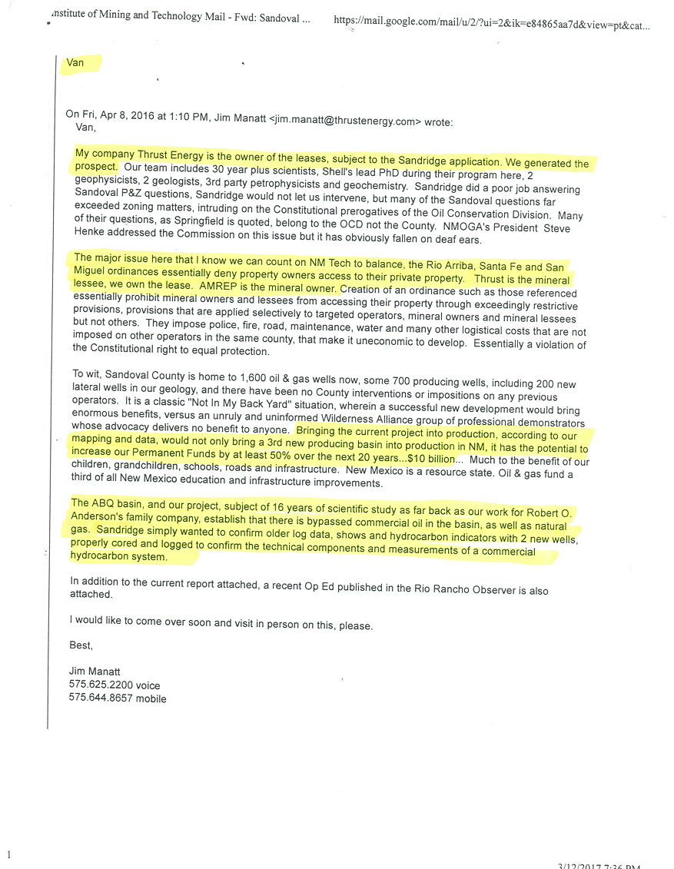
Jim Manatt Letter on Fracking Expansion

Slide 18
Collusion with Industry
Daniel Fine has been one of the NM Tech consultants to Sandoval County. His objective credentials have always been in question. The link to this Farmington Daily Times article should leave no doubt to these concerns, which need to be raised to the P and Z and County Commission.
http://www.daily-times.com/story/news/local/four-corners/2016/12/09/energy-expert-talks-future-us-energy/
Did Sandoval County just give Cart Blanc checks to NM Tech? Just how is public policy NM TECH’s forte, escapes me, for they will have no authority to enforce any regulation and gives the oil and gas industry first stab at drafting the Sandoval county oil and gas ordinance. There have been numerous studies of the hydrology in Sandoval, Bernalillo and Valencia Counties which are most likely the most studied areas in country on water quantity and quality. The need for more studies that may be needed but then there is cautionary tale of Garbage in garbage out of bad science reports and recommendations as Many people do not consider NMTech and the Energy Policy institute exactly an independent third party. (Established by nm Legislature in 2007)

Slide 19
More Issues
NMOGA recent presentation on May 4th to the Sandoval County Commission included the Garrity Group PR Firm Hired for the Fight that will be ensuing in the coming weeks. http://garritypr.com/home
The Hertiage Foundation (Koch Brothers) Funded Rio Grand Foundation Paul Gessing and Federal Government Overreach June 26, 2016 by nmogaone Energy New Mexico talks with Paul Gessing of the Rio Grande Foundation about issues facing oil and natural gas in New Mexico. A common theme of many of these issues is overreach by the Federal Government. If you would like to hear more from Paul you can catch recorded versions of his radio show here.Listen to recent Energy New Mexico radio broadcasts here.
Challenge: While preparing to defend proposed rules from the New Mexico Environment Department that would inevitably shape the future of the state’s copper mining industry, The New Mexico Mining Association engaged The Garrity Group to spearhead a digital and online approach.

Slide 20
Action Plan
File a Class action law uit Prior to Damages for all private property owners. This will require us to develop baseline studies of air and water.
We have filed a law suit against the county of Sandoval on IPRA case where the County is maintaining national Secuirty against terrorism to withhold a public document in which other counties have them on their public information websites.
Allies' Building Require Outreach to Towns villages and Pueblos to ask them to join us the Citizens Science Project for Sandoval County.
Formulate a Sustainable Groundwater Ordinance in which stakeholders work on a regional basis to develop protections to the water supply. The Oil and gas industry is exempt and they can legally do a water basin transfer of withdrawn water here to deposit in other aquifers. For their drilling processes that leave aquifers contaminated.
Develop Event planning Fundraising, grant writing to bring in funding for projects
OIL AND GAS ORDINANCE
Submit findings for the Record in the Oil and gas ordinance. An ordinance for Bernalillo
RESEARCH -
Citizens Science BASELINE STUDIES - Developing parmeters for testing
http://citsci.org/cwis438/websites/citsci/home.php?WebSiteID=7
https://crowdcrafting.org Create and Project and Get others to Analyse your data.
http://crowdandcloud.org/watch-the-episodes/episode-one Citizens Science across the USA
FUNDRAISING -
For Court Action Class Action law Suit and expenses in running NGO
For IPRA Law Suit
Event planning Concert Series.
OUTREACH / TABLING /
Citizens Tabling at Farmers markets and other events
MEDIA SOCIAL MEDIA AND WEBSITE
Writers, and media outreach.

Slide 21
Common Ground Rising
www.commongroundrising.org
Stop Fracking the Rio Grande Valley Facebook page
StoptheFrackAttack.blogspot.com
505 604-9772
info@commongroundrising.org
Donations: Checks over $100 make checks to:
ABQ Center of P&J
Common Ground Community Trust in the memo line

